Slide 1

Data Compression – Comparing Haar Algorithms
Presenters: Liel Berniker, Noy Osi, Dvir Segal Instructor: Prof. Dana Shapira

Slide 2


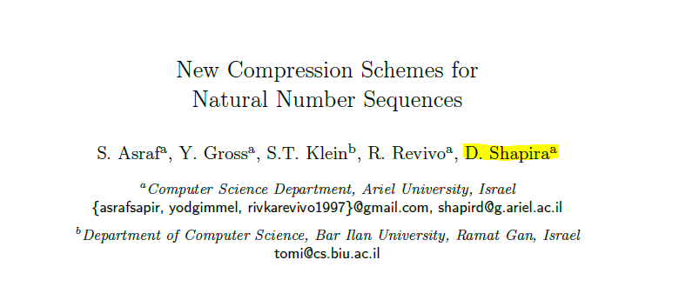
Sources:
Article

Slide 3
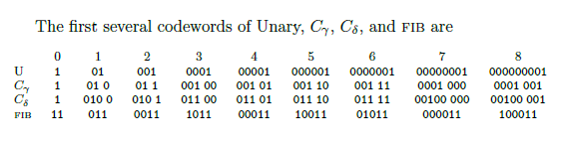
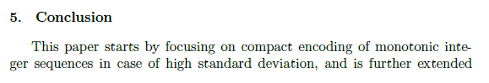
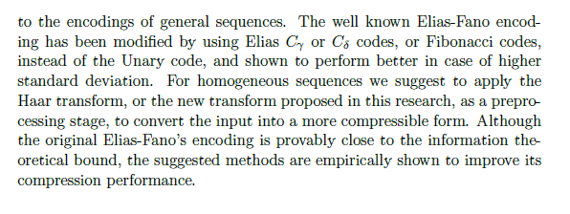
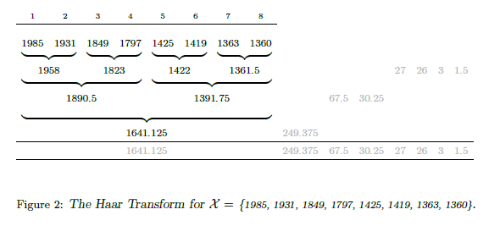
Emphasis in the article:
Coding algorithms examples
Conclusion
Haar wavelet transform example

Slide 4
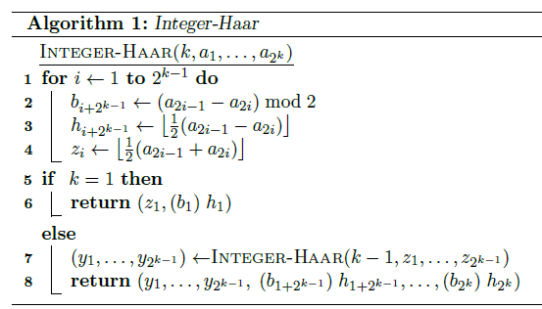
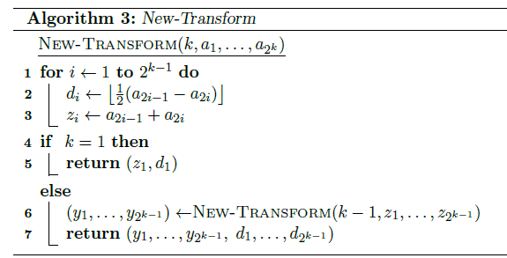
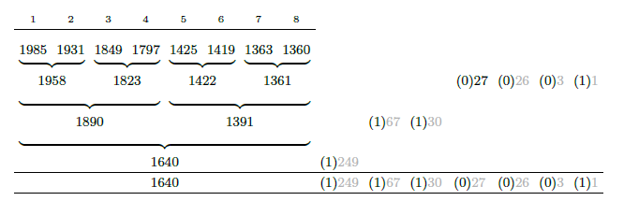
Haar algorithms
Integer-Haar
Haar New Transform

Slide 5
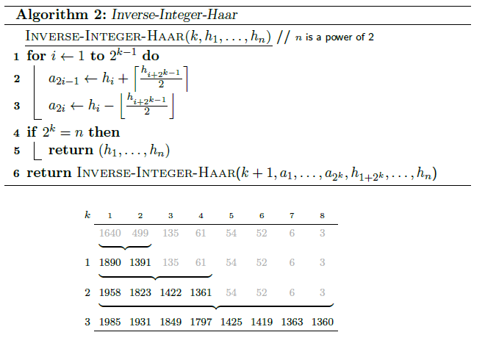
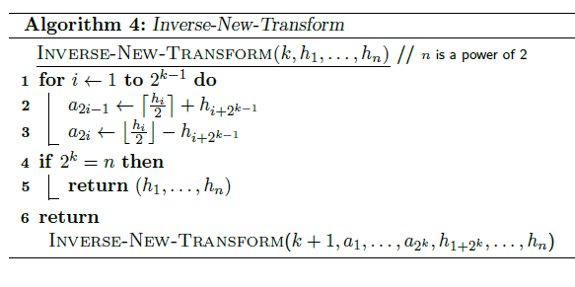
Haar inverse algorithms
Integer-Haar inverse
Haar New Transform inverse

Slide 6



Data compression coding algorithms:
Unary coding
Elias Codes – C gamma
Elias Codes – C delta
Fibonacci coding
תמונה זו מאת מחבר לא ידוע ניתן ברשיון במסגרת CC BY-NC

Slide 7

graphs & charts:

Slide 8
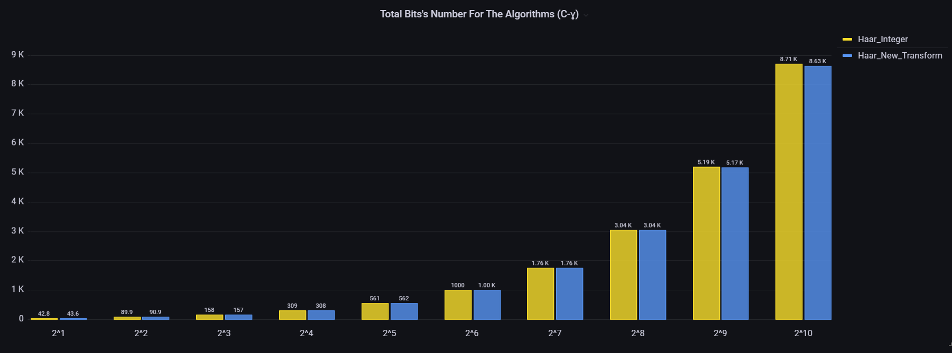
C Gamma code – average bit size compare:

Slide 9
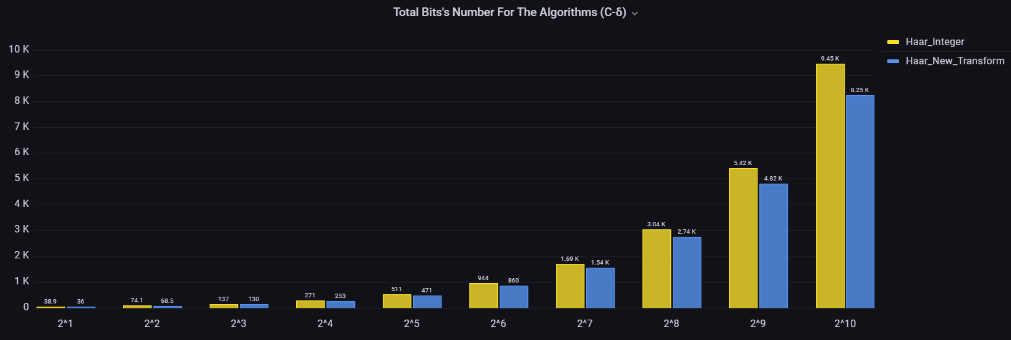
C Delta code – average bit size compare:

Slide 10

Fibonacci code – average bit size compare:

Slide 11
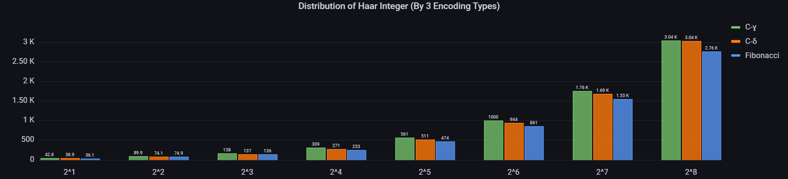
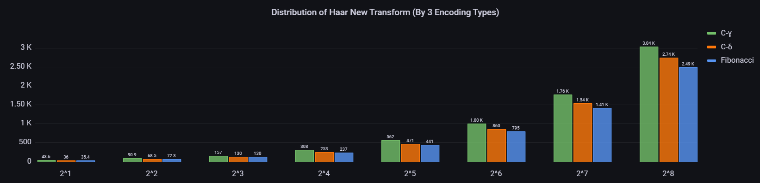

Slide 12

תודה!
Check our GitHub : https://github.com/Dvir-Segal/Data-Compression.git

